Slide 1

Customer Shopping Behavior Analysis
Analyzing 3,900 purchases to uncover spending patterns, product preferences, and subscription behavior for strategic business decisions.

Slide 2

Project Overview & Dataset Summary
Project Goal
Uncover insights from transactional data to guide business decisions.
Dataset Size
3,900 rows, 18 columns of customer and purchase details.
Key Features
Demographics, purchase details, shopping behavior, subscription status.
Missing Data
37 values in Review Rating column.

Slide 3
Exploratory Data Analysis: Python
01
02
03
Data Loading & Exploration
Missing Data Handling
Column Standardization
Imported dataset with pandas, checked structure and summary statistics.
Imputed missing 'Review Rating' values using median per category.
Renamed columns to snake_case for readability.
04
05
Feature Engineering
Database Integration
Created 'age_group' and 'purchase_frequency_days'.
Loaded cleaned data into PostgreSQL for SQL analysis.

Slide 4
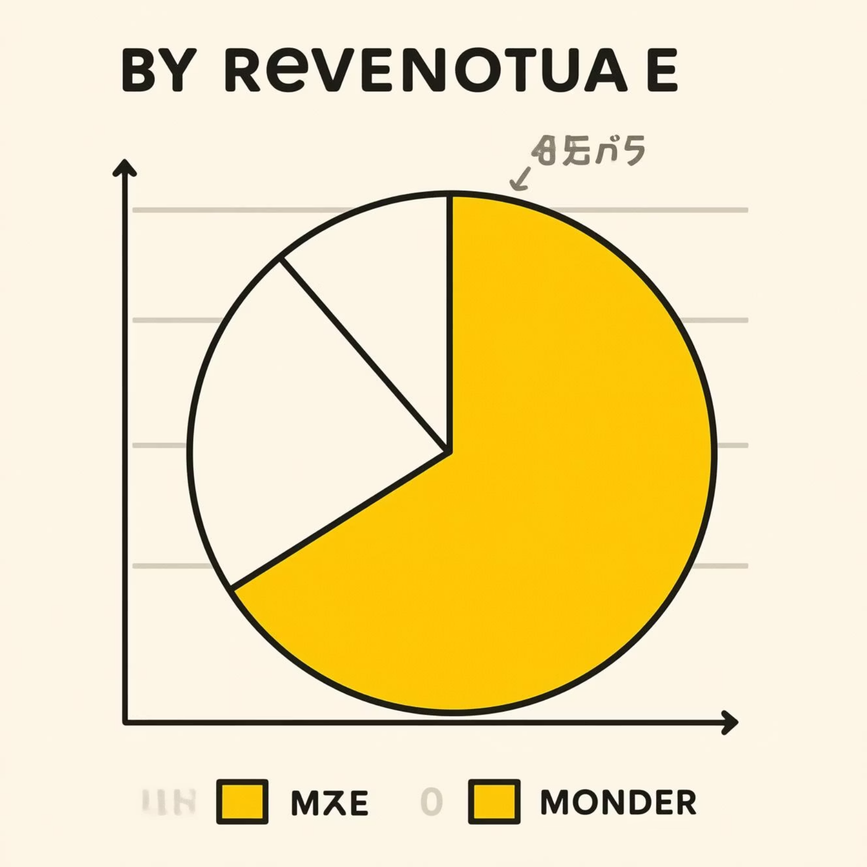
SQL Analysis: Revenue & Discounts
Revenue by Gender
High-Spending Discount Users
Male customers generated significantly more revenue.
Identified 839 customers who used discounts but spent above average.
Female
75191
Male
157890

Slide 5
SQL Analysis: Product Insights
Top 5 Products by Rating
Discount-Dependent Products
Products with highest percentage of discounted purchases.
Gloves
3.86
Sandals
3.84
Hat
50.00
Boots
3.82
Sneakers
49.66
Hat
3.80
Coat
49.07
Skirt
3.78
Sweater
48.17
Pants
47.37

Slide 6


SQL Analysis: Shipping & Subscriptions
Shipping Type Comparison
Subscribers vs. Non-Subscribers
Express shipping users have higher average purchase amounts.
Non-subscribers contribute more total revenue.
Subscribers: $62,645
Standard: $58.46
Non-subscribers: $170,436
Express: $60.48

Slide 7



SQL Analysis: Customer Segmentation
New
1
83 Customers
Returning
2
701 Customers
Loyal
3
3116 Customers
Most customers are loyal, indicating strong retention.

Slide 8
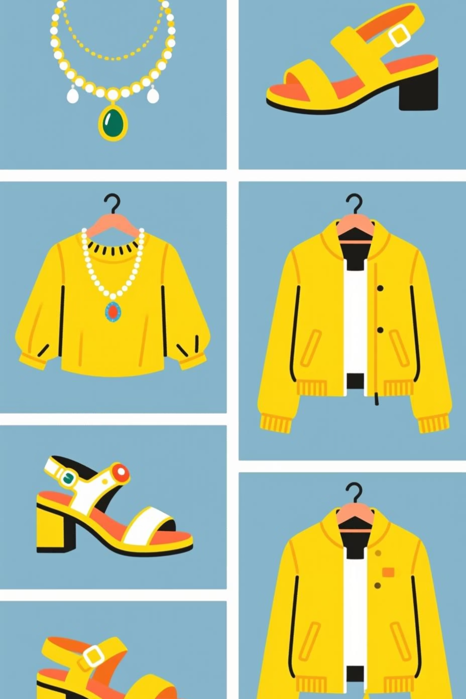
SQL Analysis: Top Products by Category
Accessories
Jewelry (171)
Sunglasses (161)
Belt (161)
Clothing
Blouse (171)
Pants (171)
Shirt (169)
Footwear
Sandals (160)
Shoes (150)
Sneakers (145)
Outerwear
Jacket (163)
Coat (161)

Slide 9
SQL Analysis: Repeat Buyers & Revenue by Age
Repeat Buyers & Subscriptions
Revenue by Age Group
Customers with >5 purchases are less likely to subscribe.
Young Adults contribute the most revenue.
No
2518
Young Adult
62143
Yes
958
Middle-aged
59197
Adult
55978
Senior
55763

Slide 10





Business Recommendations
Boost Subscriptions
Promote exclusive benefits to increase subscriber base.
Customer Loyalty Programs
Reward repeat buyers to foster loyalty and retention.
Review Discount Policy
Balance sales boosts with profit margin control.
Targeted Marketing
Focus efforts on high-revenue age groups and express-shipping users.

